Slide 1



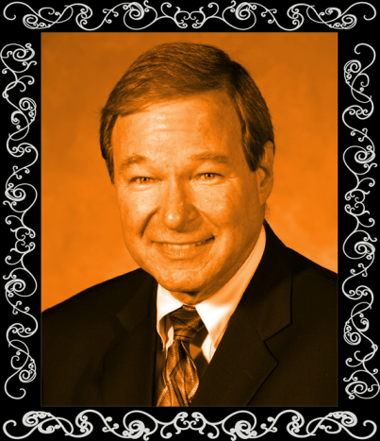



“Is There Scientific Evidence for the Existence of God?”
?
Kayser Auditorium, Hankamer School of Business, Baylor University, Monday, Sept. 16, 6 P.M.
Walter Bradley (B.S., Ph.D. University of Texas at Austin) is Distinguished Professor of Engineering Emeritus at Baylor. He comes to Baylor from Texas A&M University where he helped develop a nationally recognized program in polymeric composite materials. At Texas A&M, he served as director of the Polymer Technology Center for 10 years and as Department Head of Mechanical Engineering, a department of 67 professors that was ranked as high as 12th nationally during his tenure. Bradley has authored over 150 refereed research publications including book chapters, articles in archival journals such as the Journal of Material Science, Journal of Reinforced Plastics and Composites, Mechanics of Time-Dependent Materials, Journal of Composites Technology & Research, Composite Science & Technology, Journal of Metals, Polymer Engineering & Science, and Journal of Materials Science & refereed conference proceedings.
Dr. Bradley has secured over $5.0 million in research funding from NSF grants (15 yrs.), AFOSR (10 years), NASA grants (10 years), and DOE (3 years). He has also received research grants or contracts from many Fortune 500 companies, including Alcoa, Dow Chemical, DuPont, 3M, Shell, Exxon, Boeing, and Phillips.
Dr. Walter Bradley Distinguished Professor Baylor University
?
?
Nourishing Pizza & Refreshing Drinks!
?
?
Sponsored by the American Scientific Affiliation, (Baylor Student Chapter); the School of Engineering & Computer Science; the Departments of Electrical & Mechanical
Engineering, Baylor University
He co-authored The Mystery of Life Origin: Reassessing Current Theories [http://TheMysteryOfLifesOrigin.org/] and has written numerous book chapters dealing with various faith science issues, a topic on which he speaks widely.
He has received 5 research awards at Texas A&M University and 1 national research award. He has also received two teaching awards. He is an Elected Fellow of the American Society for Materials and the American Scientific Affiliation (ASA), the largest organization of Christians in Science and Technology in the world. He is a past President of the ASA.

