Slide 1
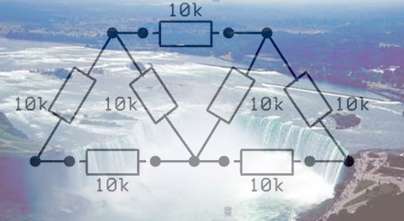

Slide 2
+
9 V
−
+
9 V
−
+
9 V
−
+
9 V
−
+
9 V
−
+
9 V
−

Slide 3
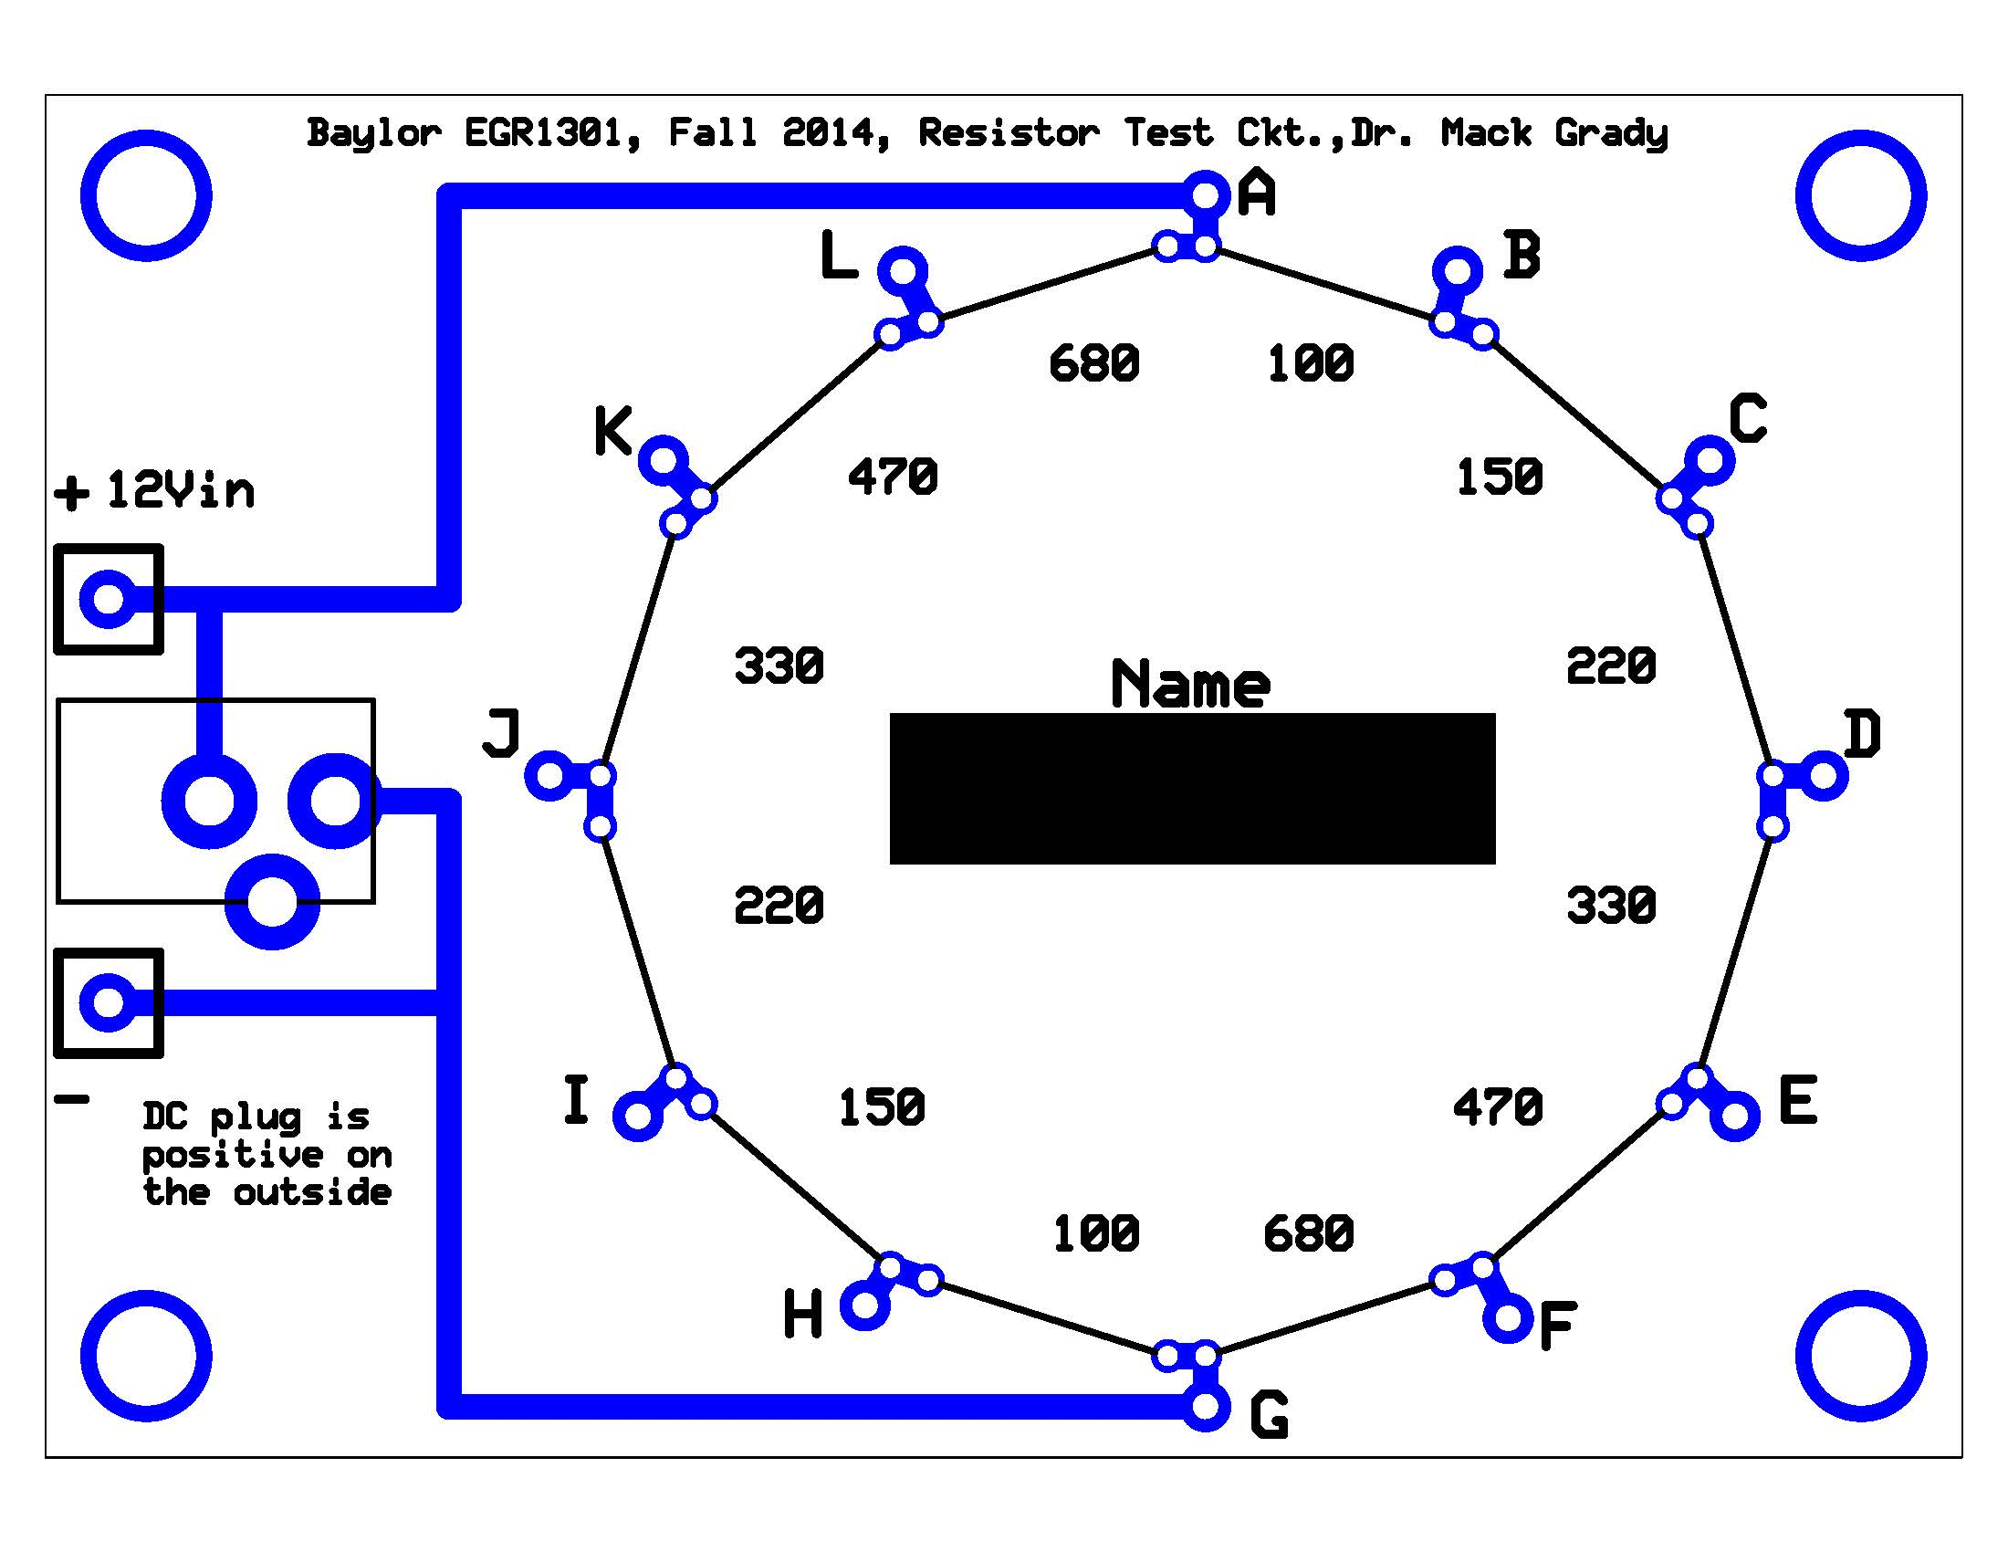

Slide 4
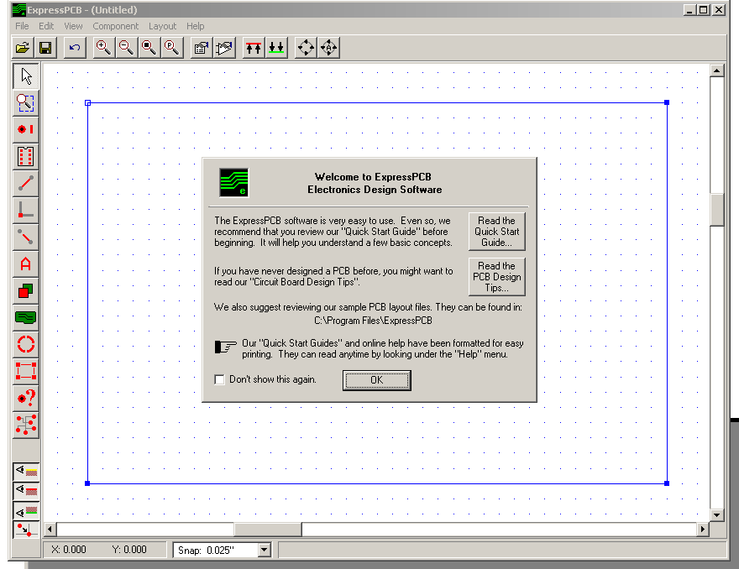
www.expresspcb.com

Slide 5
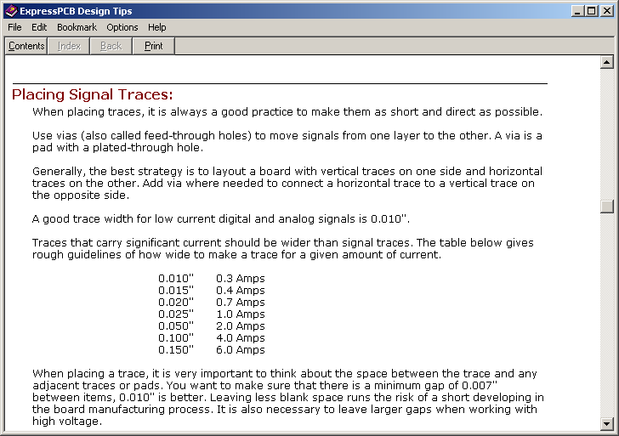

Slide 6
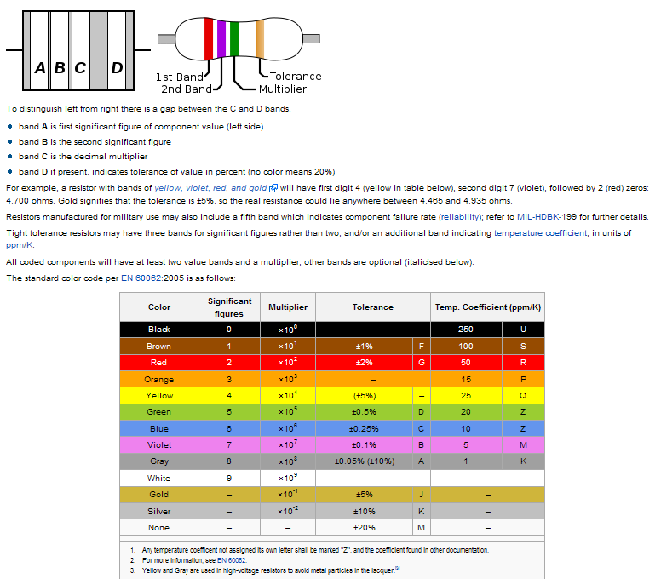
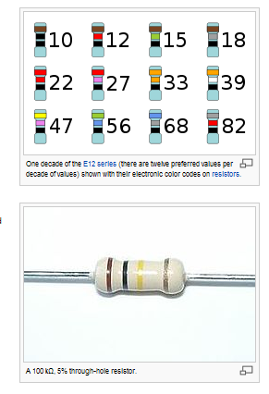
http://en.wikipedia.org/wiki/Electronic_color_code
We mostly use the boxed sizes, which increase in 1.5 multiples

Slide 7
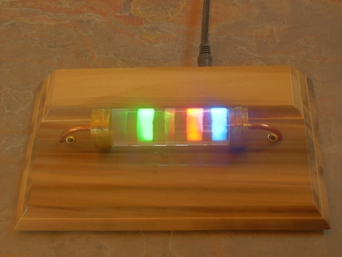
Color Code Clock

Slide 9
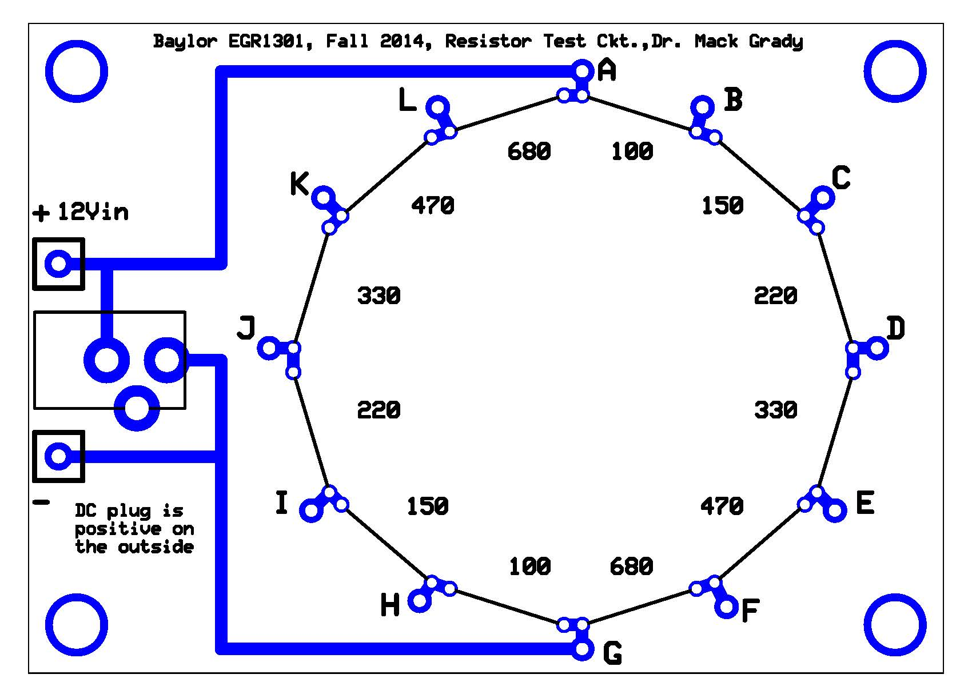

Slide 11
A linear circuit can be represented by a Thevenin Equivalent

Slide 12

Example: If you connect an external circuit to terminals E and F, the entirety of the PC board and power supply can be represented by a Thevenin equivalent circuit.
Current
R
Rth
E
Thevenin equivalent of PC Board and 12V power supply
Same current
Vth
R
F

Slide 13
12V
+
Vth = VEF voltmeter reading (or calculation)
−
12V
Isc is short circuit current through an ammeter

Slide 14
12V
+
Vth = VEF voltmeter reading (or calculation)
−
0V is having the source turned off, which is not the same as source unplugged. If the voltage source is “stiff,” 0V is approximated by unplugging the source and shorting connecting the voltage terminals together. If not “stiff,” add the source resistance to Rth.
0V
Rth = E to F ohmmeter reading (or calculation)

Slide 16
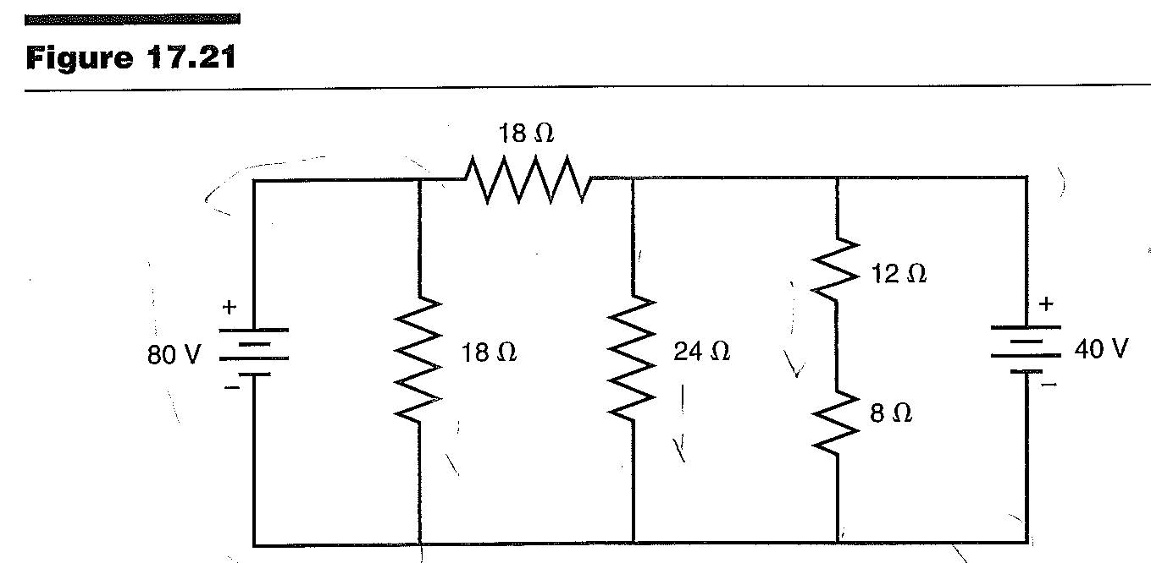

Slide 17
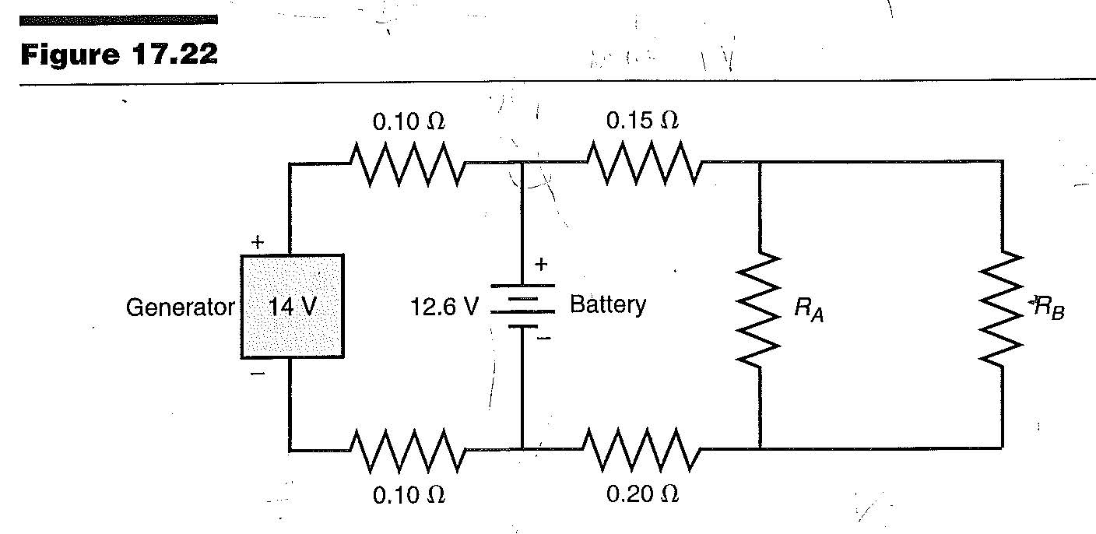

Slide 18
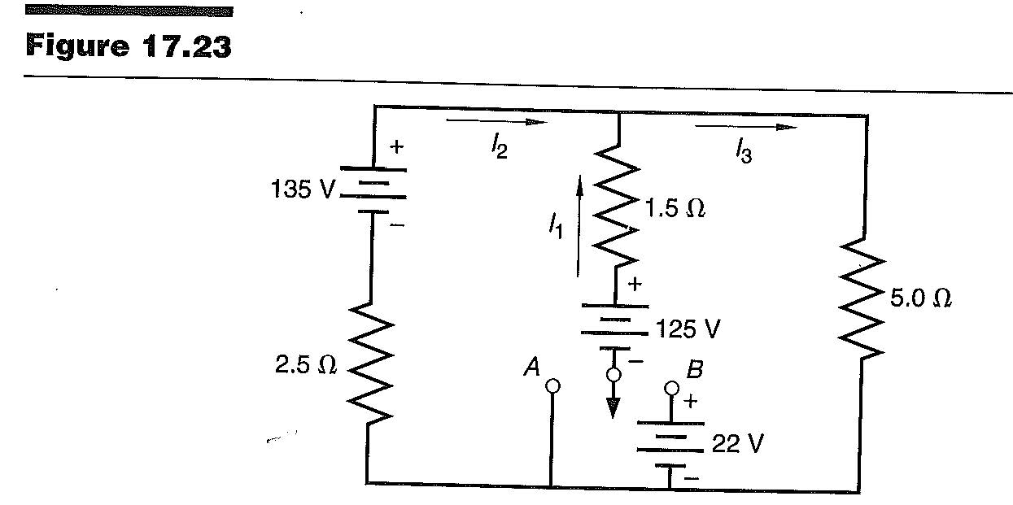

Slide 19
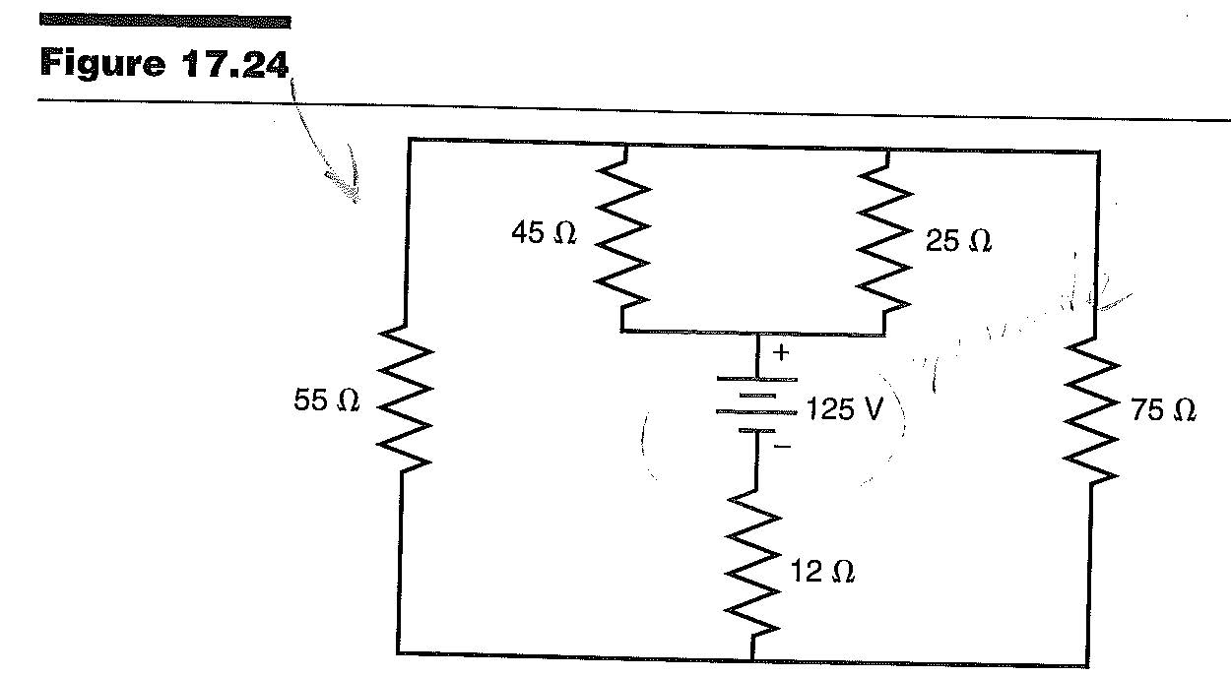

Slide 20
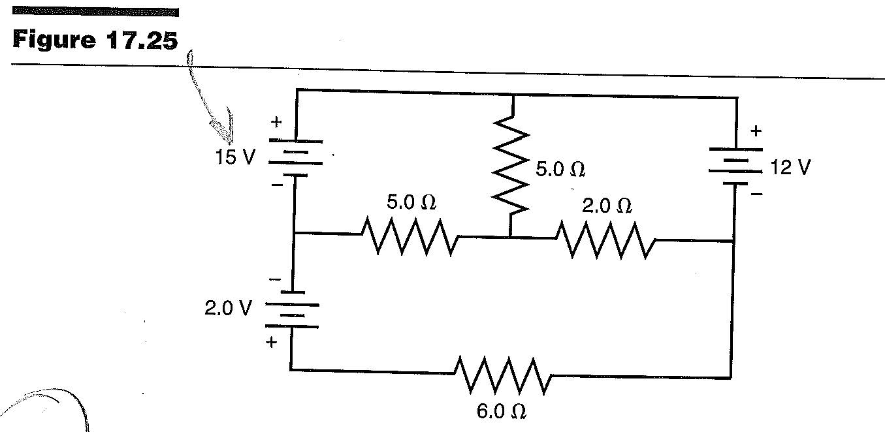

Slide 21
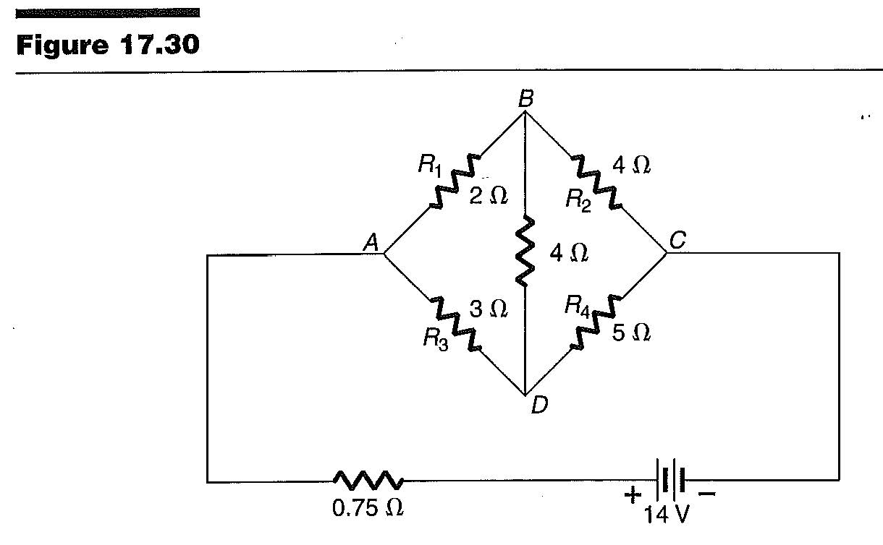

Slide 22
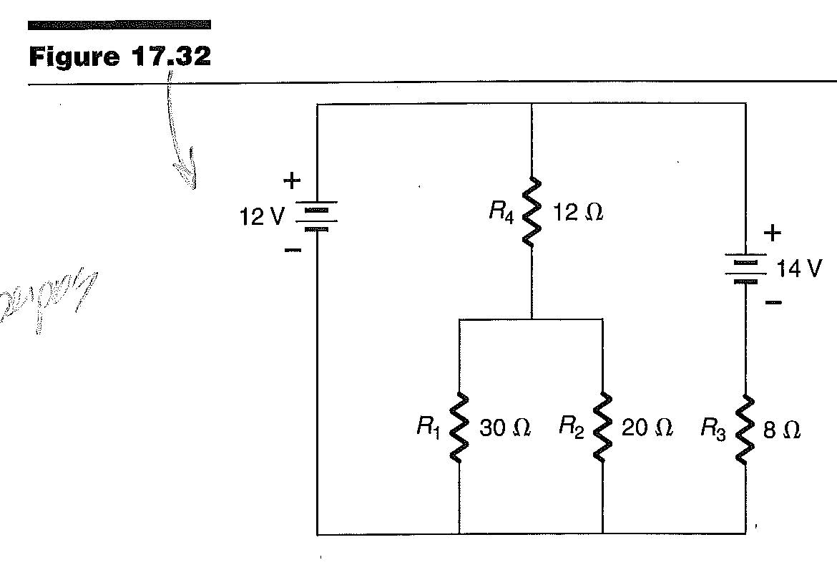

Slide 23
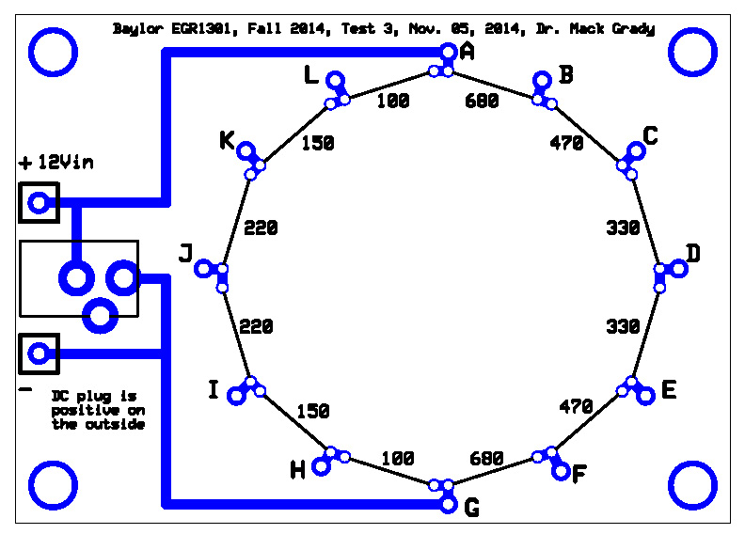
Part 1. 12V disconnected. For each of the following, compute the resistance displayed by an ohmmeter connected
Between B and D,
Between K and F,
Between D and E.
Name: ____________________________
Part 2. 12V connected. For each of the following, compute the voltage displayed by a voltmeter connected
Red probe on B, black probe on D,
Red probe on K, black probe on F,
Red probe on D, black probe on E.
Part 3. Determine the Thevenin equivalent circuit for the PC Board, with 12V connected, as seen by an external circuit connected between D and E.

Slide 24
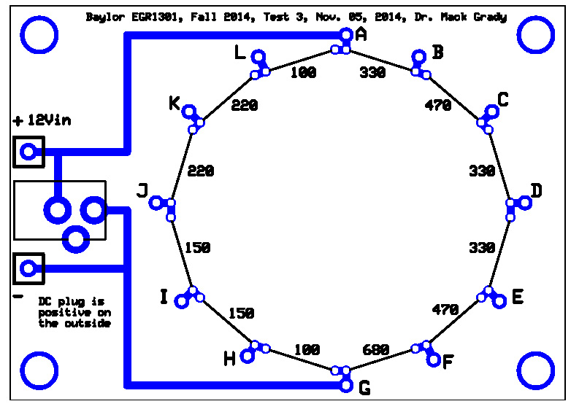
Part 1. 12V disconnected. For each of the following, compute the resistance displayed by an ohmmeter connected
Between B and D,
Between K and F,
Between D and E.
Name: ____________________________
Part 2. 12V connected. For each of the following, compute the voltage displayed by a voltmeter connected
Red probe on B, black probe on D,
Red probe on K, black probe on F,
Red probe on D, black probe on E.
Part 3. Determine the Thevenin equivalent circuit for the PC Board, with 12V connected, as seen by an external circuit connected between D and E.

Slide 25
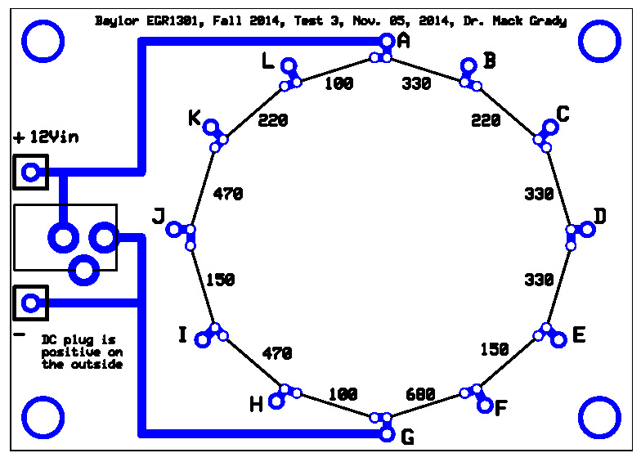
Part 1. 12V disconnected. For each of the following, compute the resistance displayed by an ohmmeter connected
Between B and D,
Between K and F,
Between D and E.
Name: ____________________________
Part 2. 12V connected. For each of the following, compute the voltage displayed by a voltmeter connected
Red probe on B, black probe on D,
Red probe on K, black probe on F,
Red probe on D, black probe on E.
Part 3. Determine the Thevenin equivalent circuit for the PC Board, with 12V connected, as seen by an external circuit connected between D and E.

