Slide 1
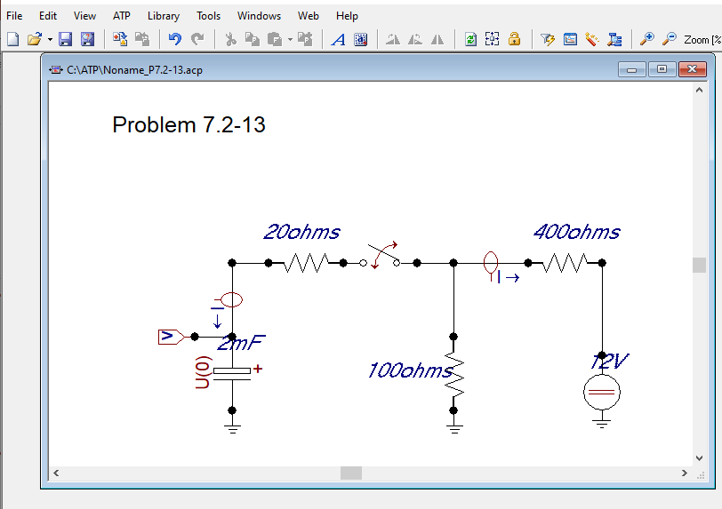
Initial V = 8V

Slide 2
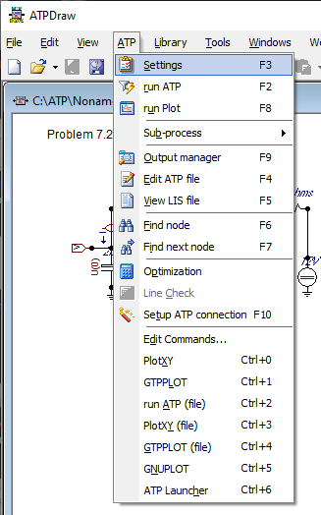
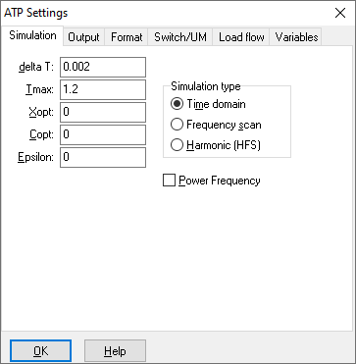
Problem 7.2-13

Slide 3
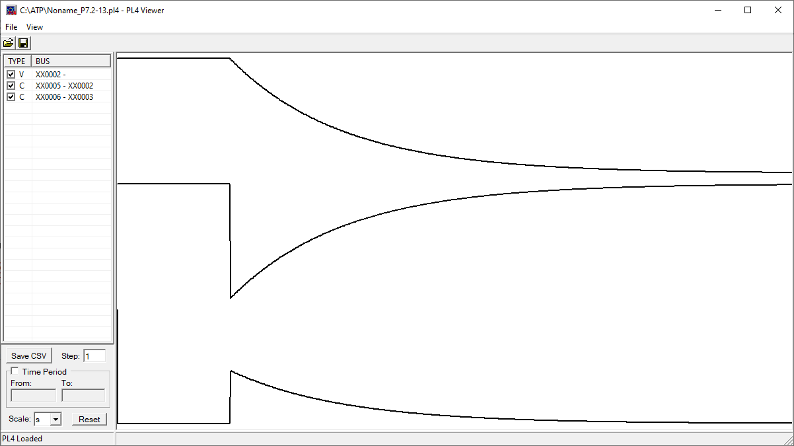
Problem 7.2-13

Slide 4
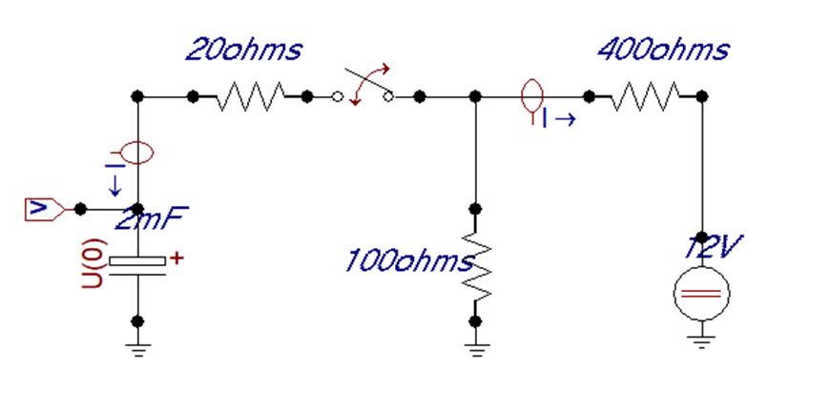
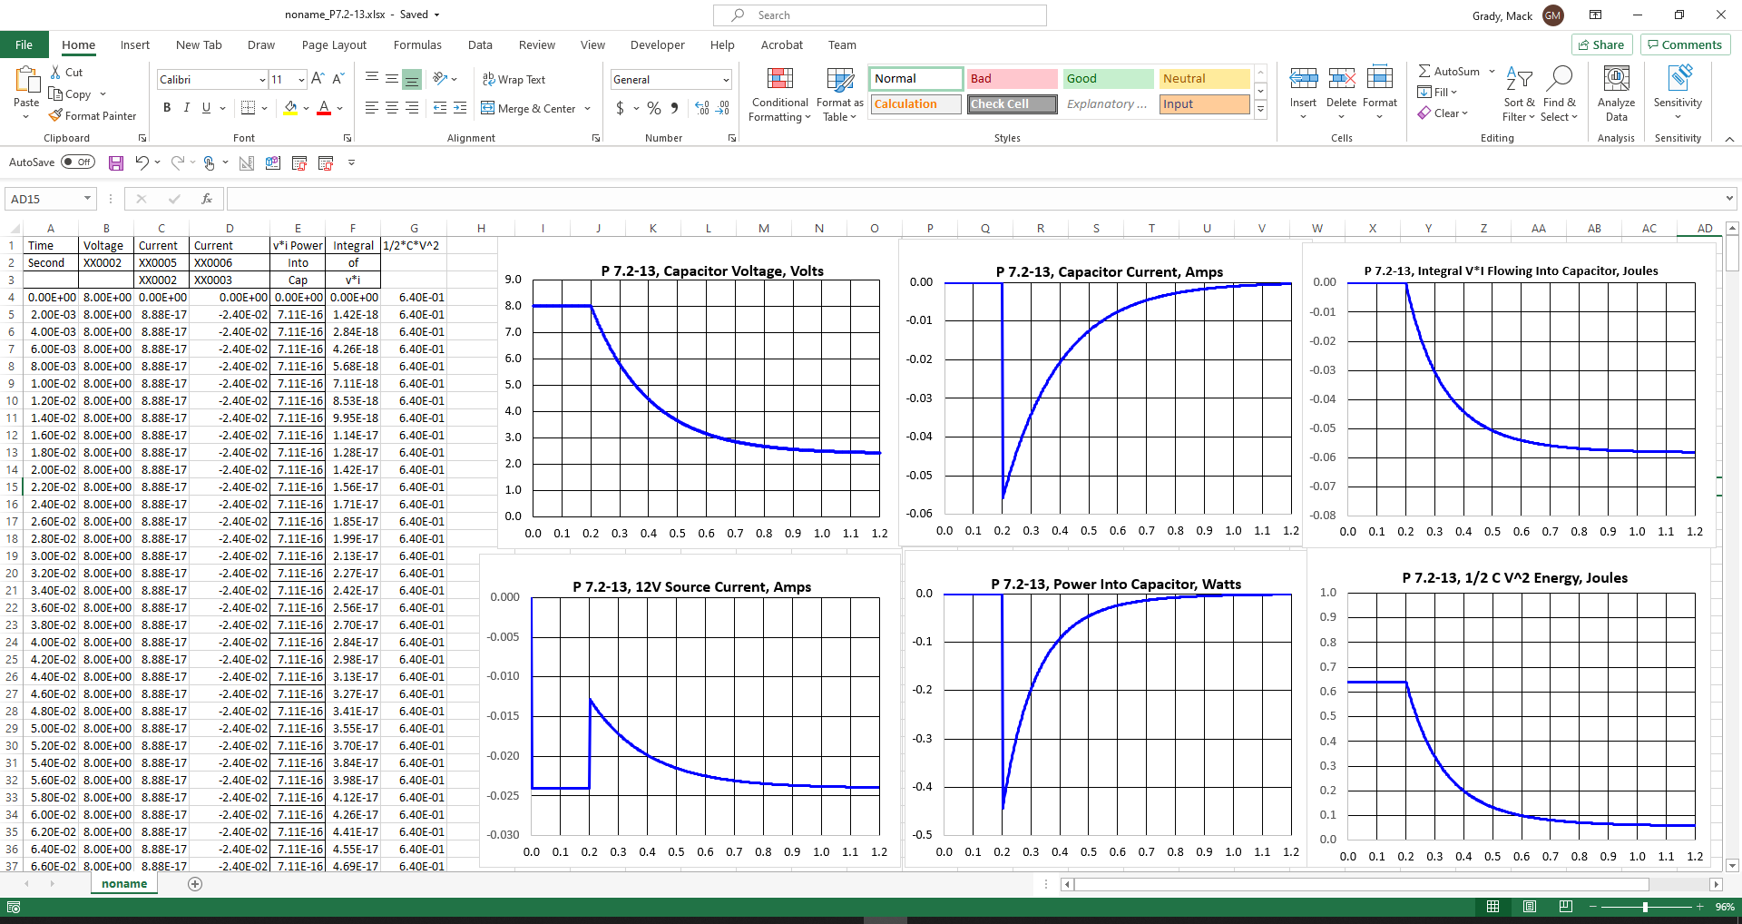
ATP Simulation of P7.2-13, 2021_0311
ATP Output
Excel Formulas
Sec
1
2
3
4
5
6
1
2
5
3
4
6

Slide 5
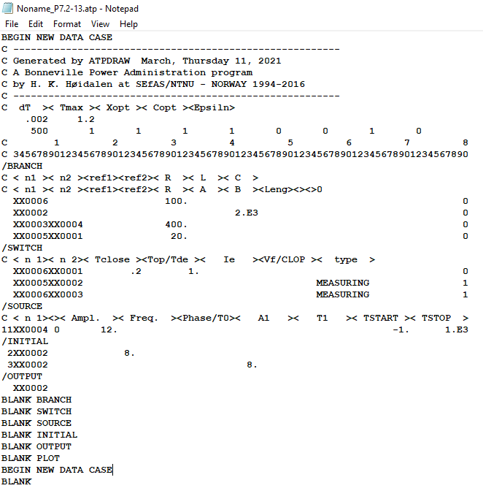
Problem 7.2-13
ATP Input File Produced by ATPDRAW

Slide 6
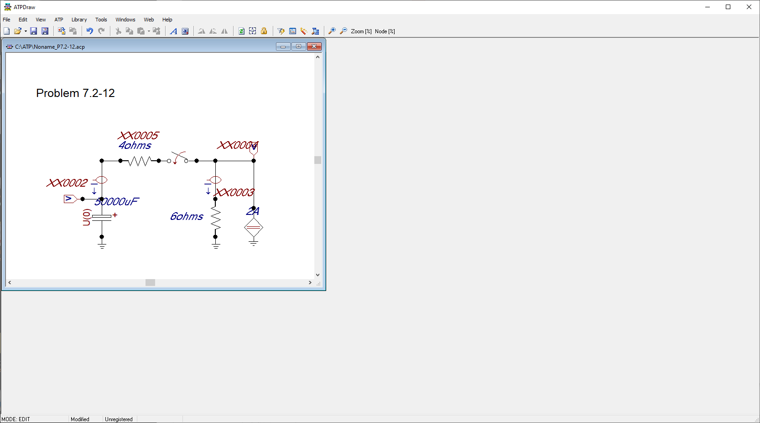

Slide 7
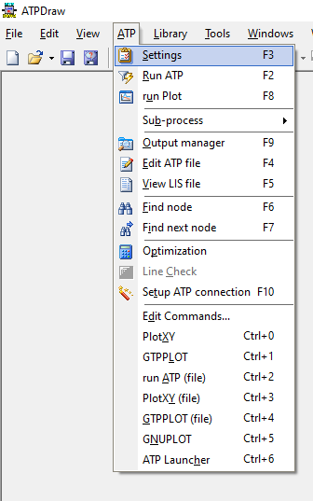

Problem 7.2-12

Slide 8
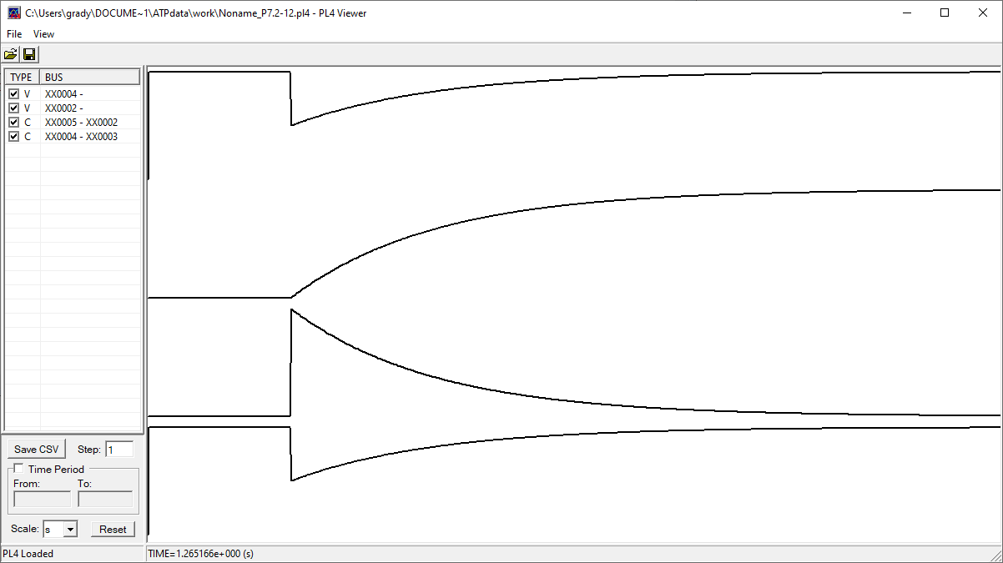
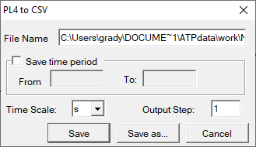
Problem 7.2-12

Slide 9
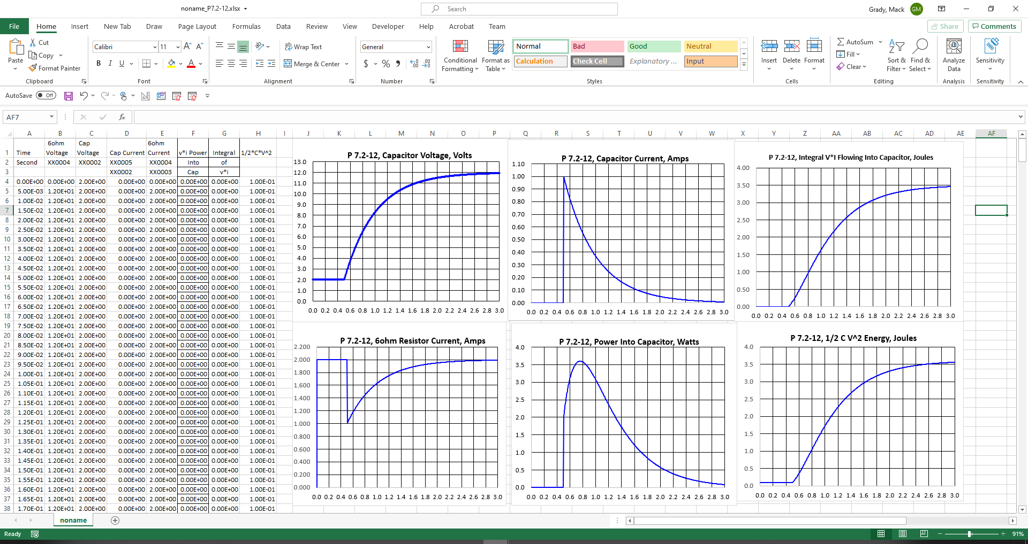
ATP Simulation of P7.2-12, 2021_0311
ATP Output
Excel Formulas
1
2
5
3
4
6

