Slide 1
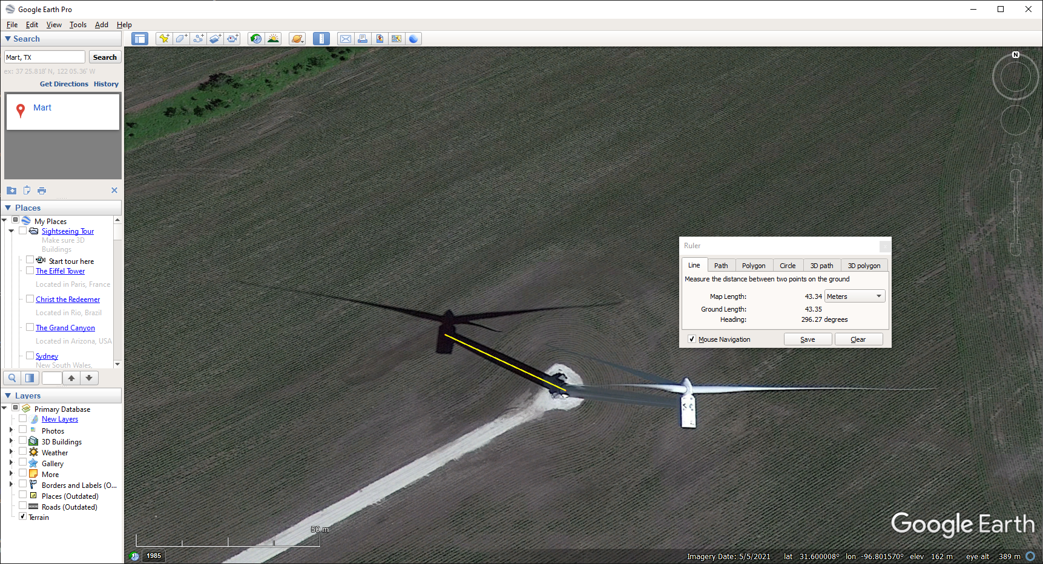
One of Mart’s Wind Farm Turbines. Use the tower’s shadow length to determine the tower’s height

Slide 2
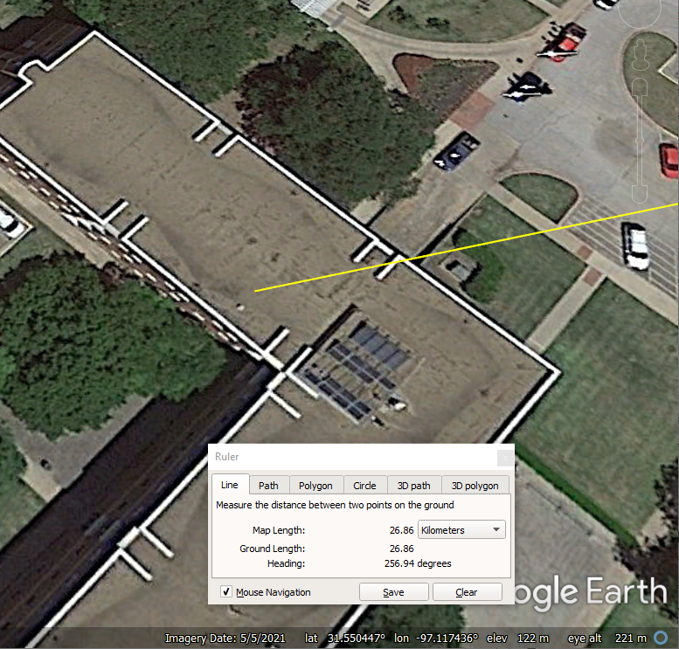
Distance and Direction From Our Classroom to the Wind Turbine
Our Rogers Classroom
Straight Line to
the Wind Turbine

Slide 3
One of Mart’s Wind Farm Turbines. Use the tower’s shadow length to determine the tower’s height
Distance and Direction From Our Classroom to the Wind Turbine
Our Rogers Classroom
Straight Line to
the Wind Turbine

